Slide 1



Caturanga
Simplifying Aid while Amplifying Impact

Slide 2
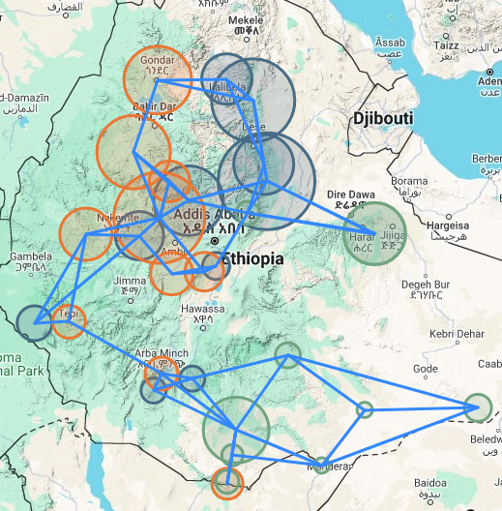
Today´s Agenda
Problem Statement and Severity
Caturanga´s Solution Approach
Use Cases and User Benefits
Live-Demo: Running a Simulation
Our Vision for Future Development
The Team behind Caturanga

Slide 3
Qulitative data as challenge for decision making
Reactive Planning
Proacting to IDP movements rather than reacting
Adapting to dynamic conflict evolution
IDP movement influenced by locations of camps, towns and settlements
As a Result
Delayed, unequal distribution of humanitarian aid
Inefficient allocation of resources during humanitarian crises
Relocating resources and aid often unfeasible and expensive
Experience-based decision making
Anticipating Population Movements
Predicting future IDP movement through manual data analysis and personal experience

Slide 4
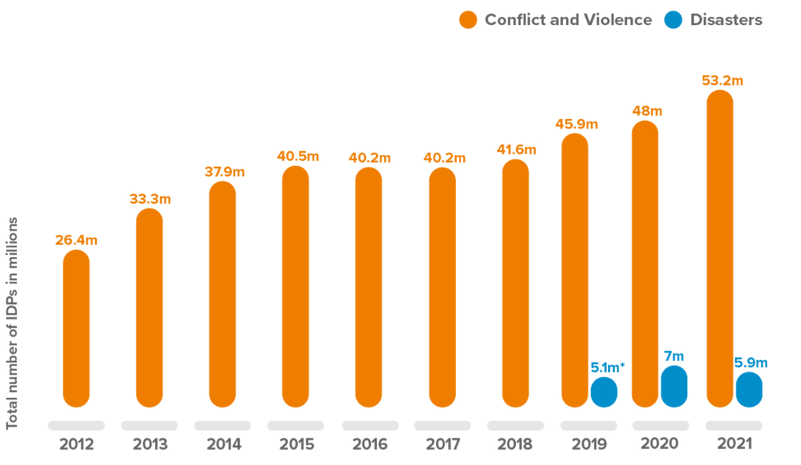
The Global Number of IDPs is Quickly Rising
"At the end of 2022, the highest number of internally displaced persons ever recorded – a staggering 71 million people – were living in internal displacement.“ (IDMC) [1]
(1)
Notes:
Rising Trend of Number of IDPs Worldwide:
- Internal displacement hits an all-time high globally at 71 million people (2022) due to new and prolonged conflicts, notably in Africa and the Middle East.
- Disaster displacement is a significant global challenge
- Displacement's impact extends beyond the immediate: Reducing future displacement risks requires proactive solutions.

Slide 5
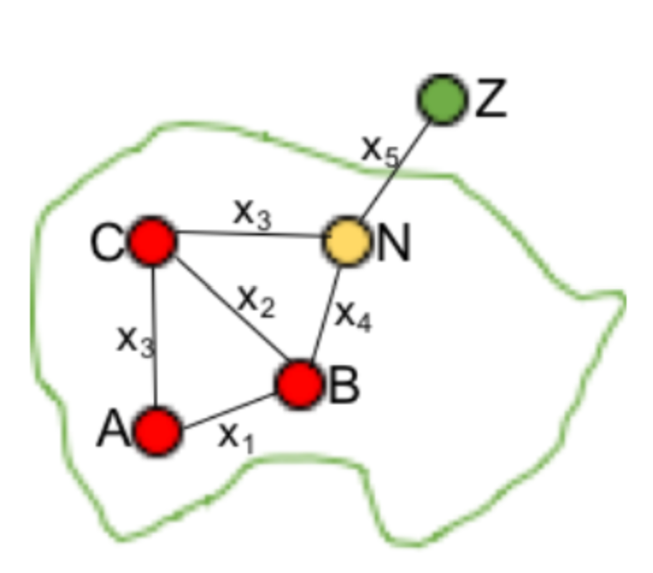

Agent Based Modelling as Caturanga´s Core Concept
Agent based modelling – Simulating IDP movement:
Simulations aim to mimic movement of IDPs in reality:
Each IDP: entity with individual movement according to a set of rules
Each IDP: interacts with and influences other IDPs and environment
Explainability through rule-based simulations
Key Indication: How many IDPs are at a given location at the beginning and the end of a simulation
Collaboration with the FLEE project: [2]
Research initiative at the Brunel University London
Past cooperation with the Columbia University, NY and Save the Children Intl.
(2)
Notes:
Collaboration with Burnel

Slide 6
Key Functionalities of Our Solution
Data Preprocessing
Simulation Configuration
Simulation Result
Retrieval of the latest conflict data from ACLED and camp population Data from IOM [3]
Displaying the data source and date of retrieval for conflict data
Predefined conflict maps and default simulation settings
Wide range of adjustable simulation settings supported by default values and descriptions of settings
Visualization of number of IDPs at all locations during the simulation period
Notes:
Keine Screenshots

Slide 7
Live Demo – Starting a Simulation
Start a new Simulation
Inspect the simulation results
Choosing a conflict region
Configuring the simulation rules
Run the simulation

Slide 8
Use Cases and User Benefits
Data Preprocessing
Simulation Configuration
Simulation Result
Combination of ACLED and IOM Data
Executing FLEE on up-to-date, preprocessed Data
Easy simulation setup through predefined simulation configuration
Convert User´s conflict knowledge into optimized simulation configurations
Simulation of IDP movements improves proactive resource planning
Visualizations increase understanding of conflics and IDPs behaviors
Predicting, when towns turn into conflict regions visible

Slide 9
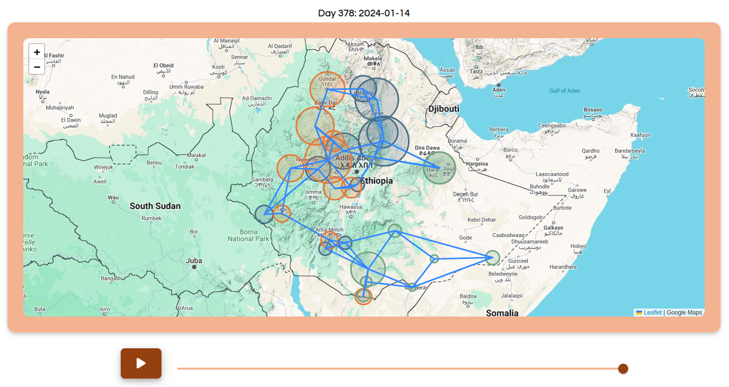
Caturanga Makes Simulating IDP Movement Accessible

Slide 10
Caturanga´s Future Development Directions – Our Vision
Promising framework for predicting and validating IDP movement based on real-time data
Current projects, conducted by the Columbia University and Save-The-Children underline the potential of simulating refugee movement
Over the long term, we envision an automated dicision support system, comprised of three main components
Automatic data preprocessing pipeline of Real-time data from various data sources
Extending simulation capabilities using Agent-Based Modelling (FLEE)
GUI for in-depth Simulation Result Analysis + Data Visualization

Slide 11
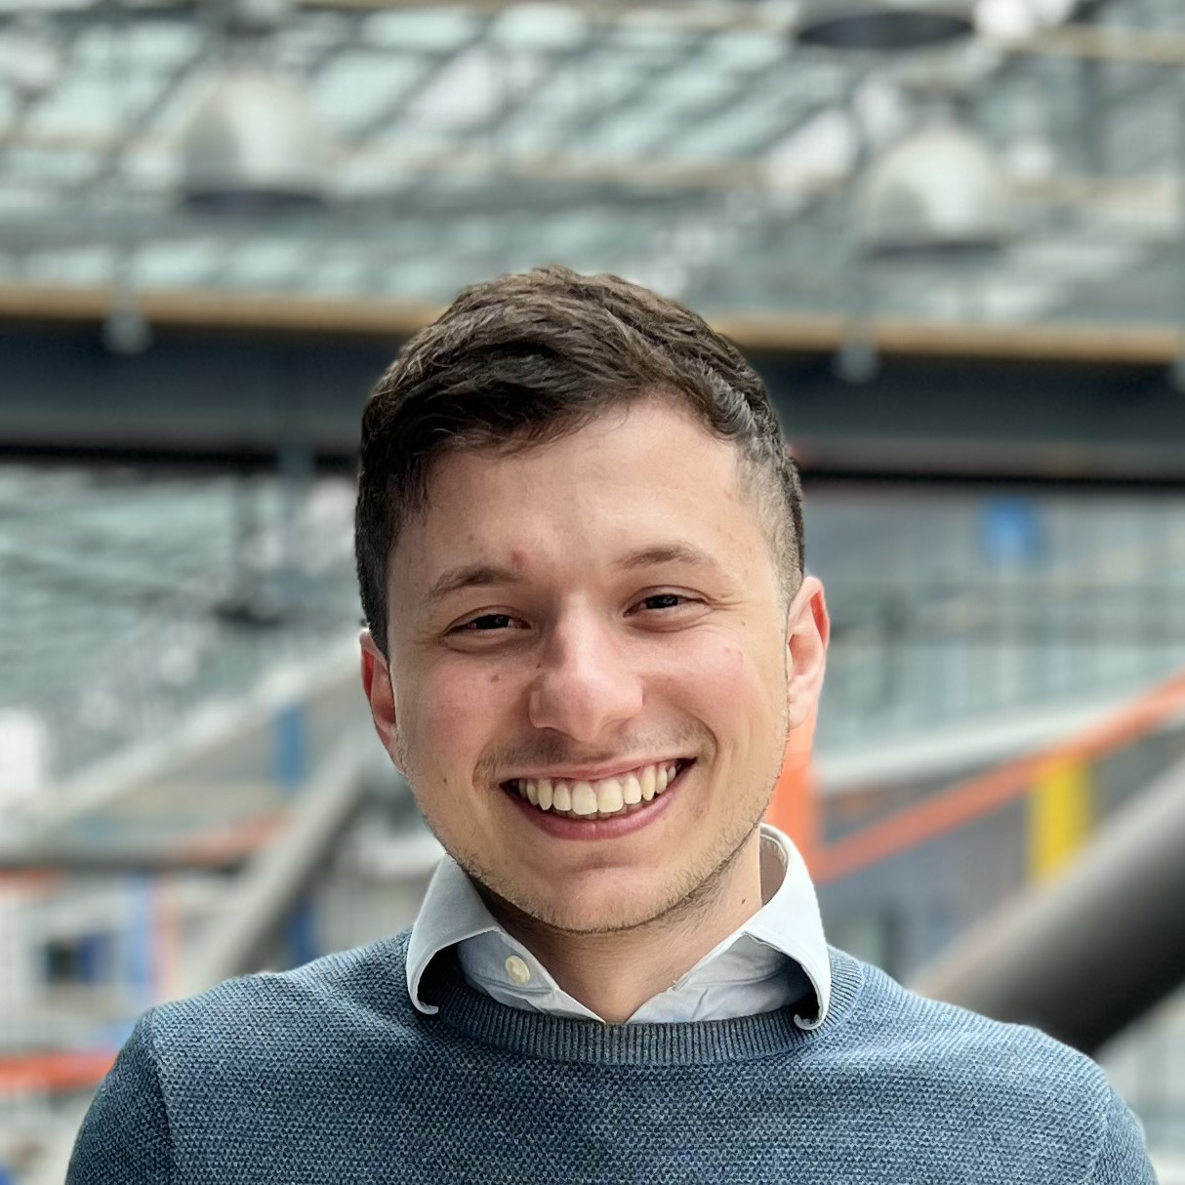
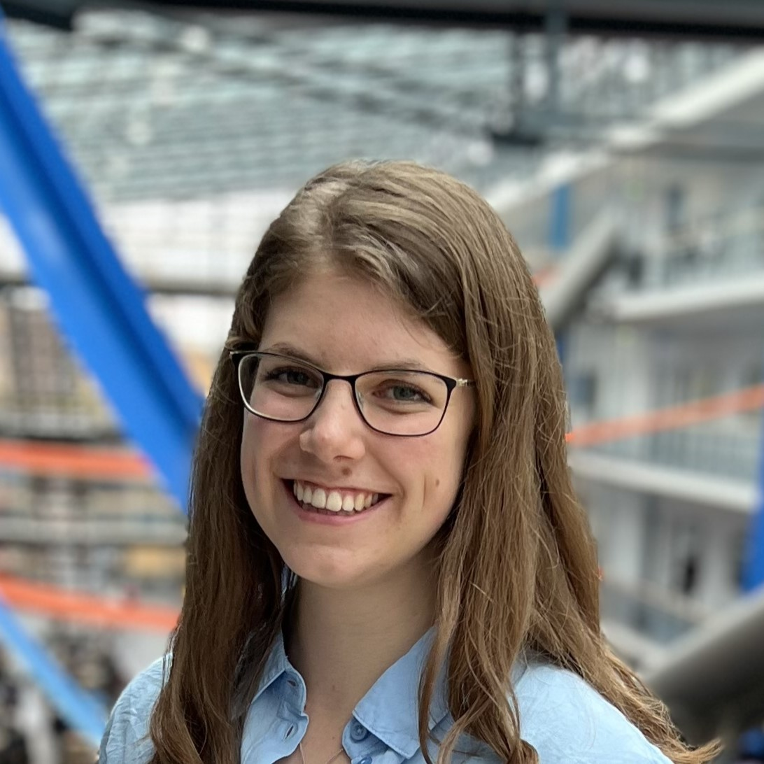
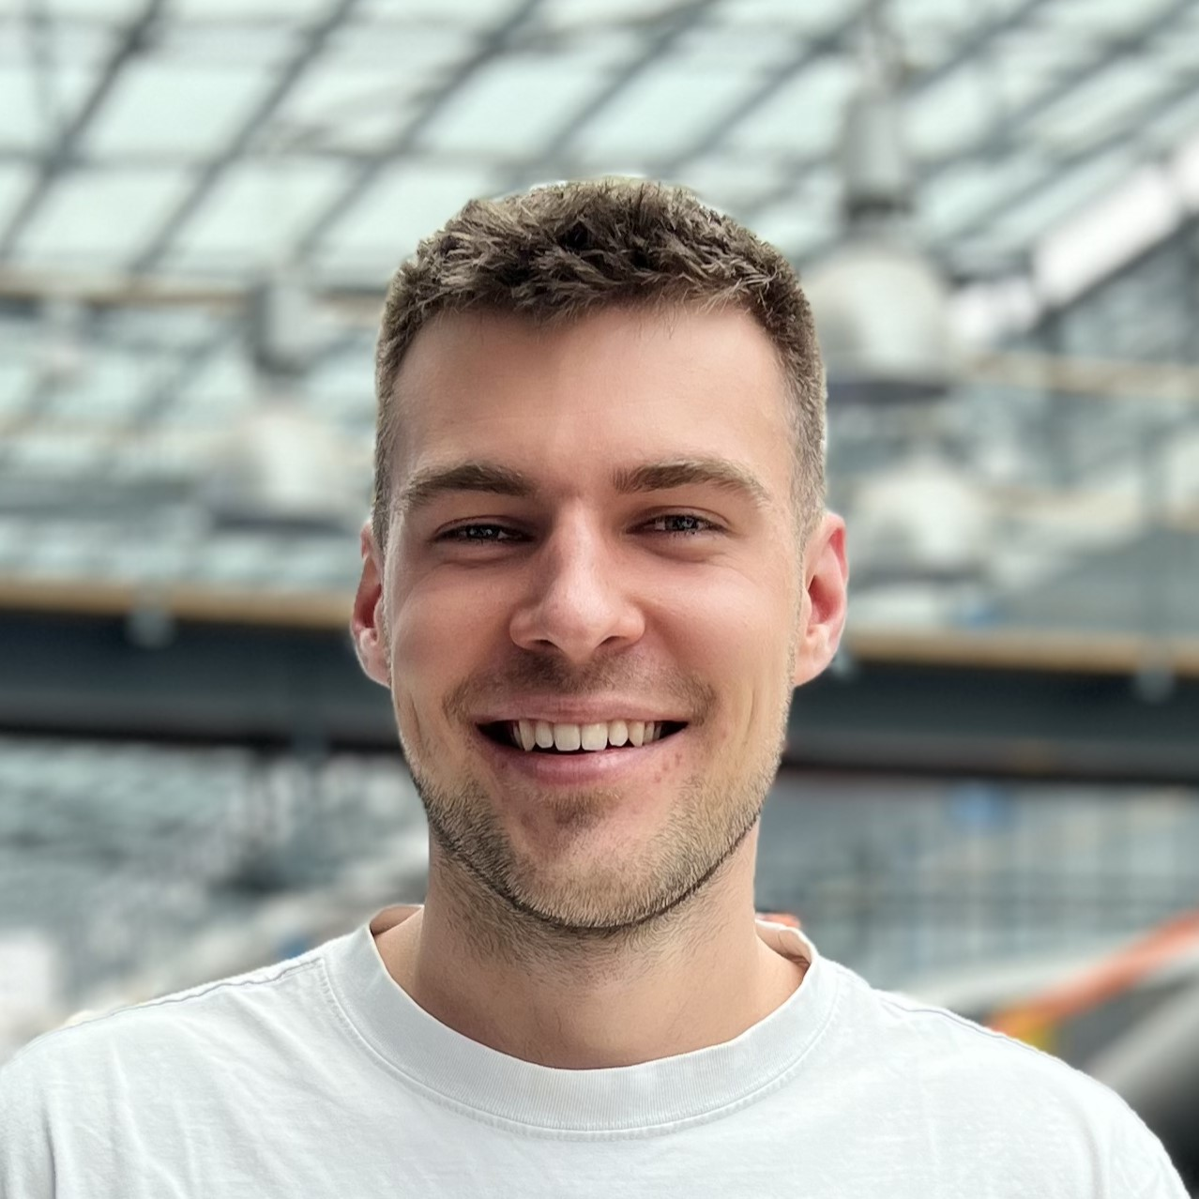
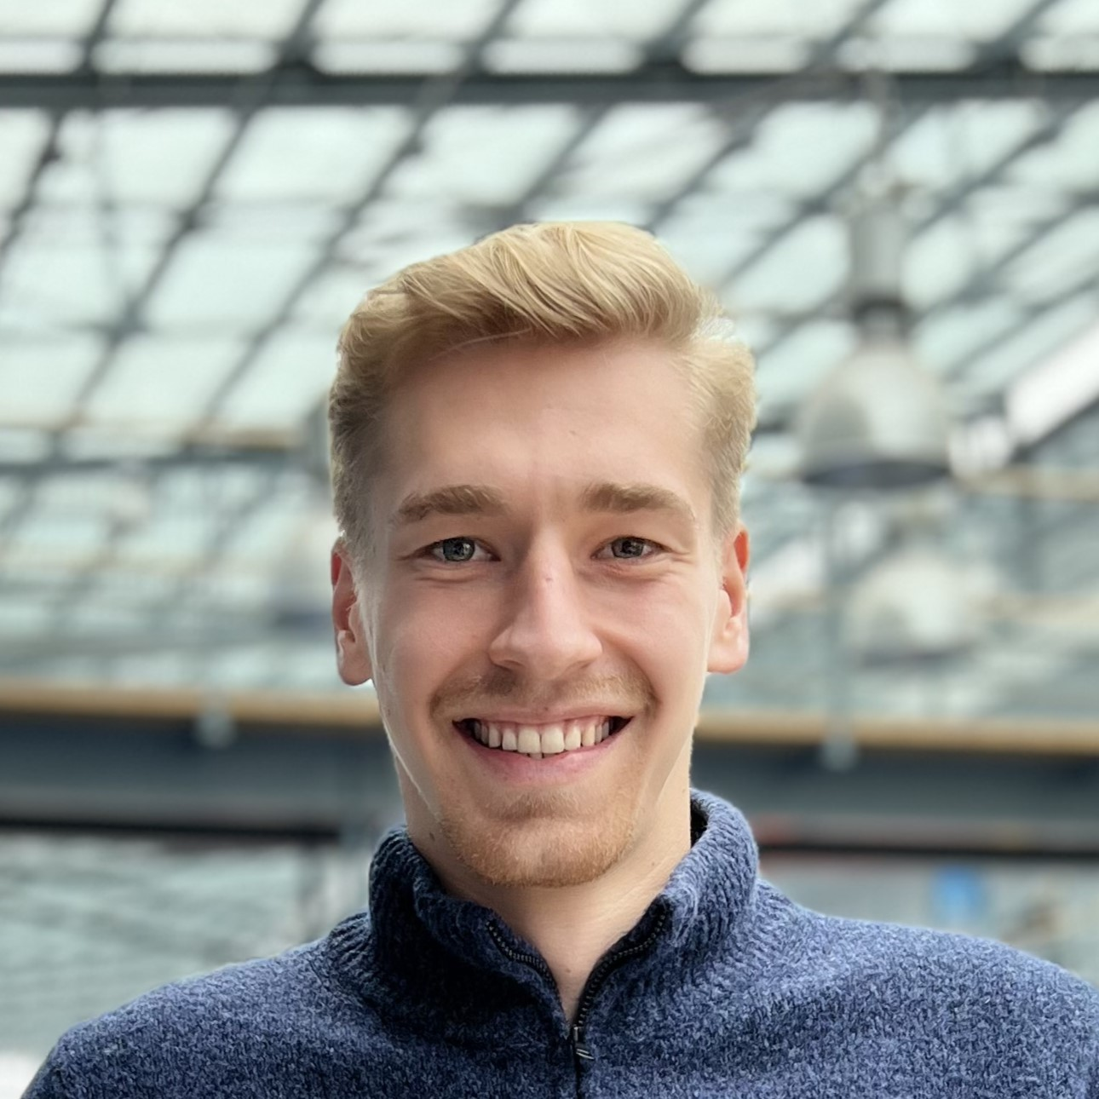

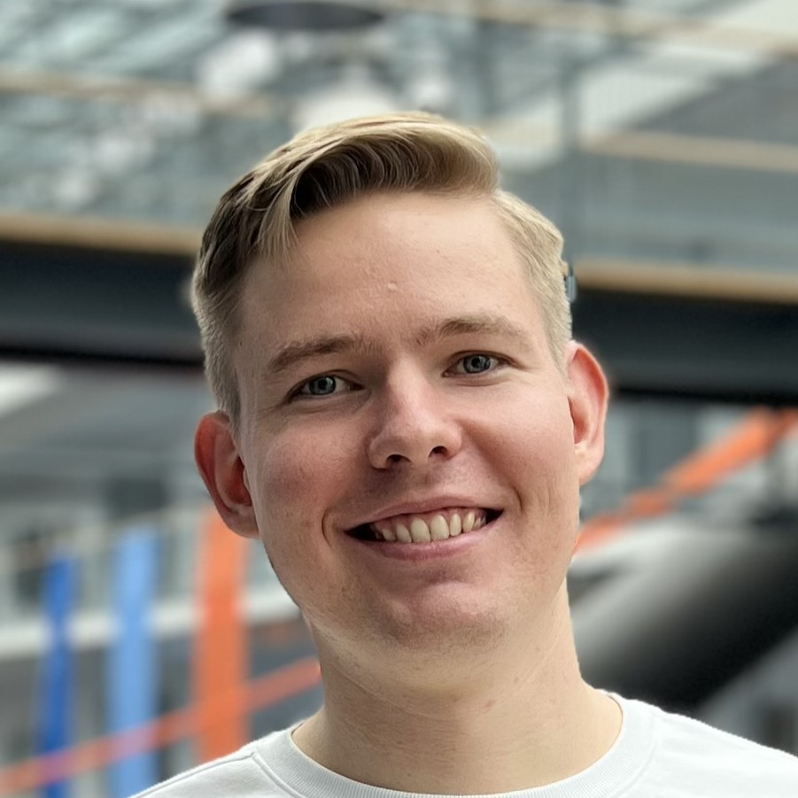
Thank You For Your Attention – Q & A
Miguel Mercano
B.Sc. Informatics
miguel.mercano@uni-a.de
Klara Cimbalnik
B.Sc. Informatics
klara.cimbalnik@uni-a.de
Nicolas Schmitt
B.Sc. Information Systems
nicolas.schmitt@uni-a.de
Pascal Wackler
B.Sc. Information Systems
pascal.wackler@uni-a.de
Jonas Maurer
B.Sc. Informatics
jonas.maurer@uni-a.de
Nils Sirrenberg
B.Sc. Informatics
nils.sirrenberg@uni-a.de

Slide 12
Appendix

Slide 13
References
Content:
[1] Report by the UN General Assembly: Vision and thematic priorities: addressing new challenges and consolidating gains
[2] Agent based Modelling framework for IDP movement: FLEE
[3] Data Source for conlict data: ACLED
Graphics:
IDMC global report on IDPs: IDMC global report on IDPs (2022)
FLEE network graphs: https://flee.readthedocs.io/en/master/Types_of_location_graphs/

Slide 14
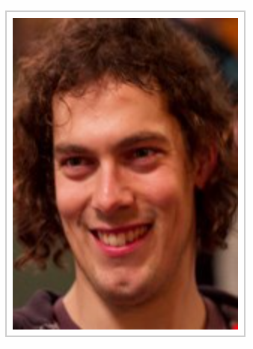
FLEE
Flee is an agent-based modelling toolkit which is purpose-built for simulating the movement of individuals across geographical locations, released under a BSD 3-clause license.
Flee is currently used for modelling the movements of refugees and internally displaced persons (IDPs). It provides users with the ability to define and use their models through a relatively straightforward application programming interface (API).
There are a range of functional tests to allow users to verify the consistency of the code results. FLEE also features a range of scripts to handle and convert data, as well as an automated plotting tool for output generated by the simulation.
Dr Derek Groen Reader in Computer Science
Mail: derek.groen@brunel.ac.uk
FLEE: https://github.com/djgroen/flee

Slide 15

C

